Slide 1

Impact of a Continued Care Social Support Group on Depression and Loneliness
Maddie Andrews, OTS

Slide 2

Overview
Capstone Site
Chesterwood Senior Living
West Chester, OH
Assisted/Independent Living and Memory Care
Topic Areas
Program Development
Leadership

Slide 3
Background
Loneliness
  Discrepancy between actual and desired social relationships
  28% of older adults in U.S. report significant loneliness
  Experienced at higher rate in continued care facilities
  Exacerbates chronic and mental health conditions
Occupational Therapy (OT) in Continued Care
  Linked to prevention of cognitive decline
  Reduces depression and feelings of loneliness
(AARP, 2012; Dreyer et al., 2018; Jansson et al., 2019; Lapane et al., 2022; Peralta et al., 2017; Naber et al., 2020; NIH, 2019)

Slide 4
Purpose
Need
Social/Leisure programming directed by Activities Staff
OT not involved in social/leisure interventions at Chesterwood
Determine the impact of an OT-led social and leisure program (Circle of Friends) on the well-being of older adults at Chesterwood Senior Living
Notes:
The purpose of this project was to determine the impact of OT led coF

Slide 5
Circle of Friends (CoF)
Group-rehab model established in Sweden
Aim: To prevent loneliness among community dwelling OAs
Design: 1 hour sessions, 1x/week, 12 week period
8 group members, 2 facilitators
CoF at Chesterwood
12 participants, avg age 82.6 yrs
1 IL and 11 AL residents
1 hour session, 1x/week, 6 week period
Purpose: Make new friends, participate in meaningful activities
Shown to reduce loneliness and improve cognition
(Routasalo et al., 2009 & Savikko et al., 2010)

Slide 6
Outcome Measures
Rapid Cognitive Screen
  Assess thinking/memory and screens for cognitive impairment
  Normal, moderate cognitive impairment, and dementia
R-UCLA Loneliness Scale
  Measures the experience of loneliness
  Scores: Low, moderate, severe loneliness
Lubben Social Network Scale
  Measures social isolation and number of social contacts
  Scores reflect risk of social isolation
Geriatric Depression Scale
  Screens for depression in OAs
  Scores: Low, moderate, severe risk for depression
(Herrmann et al., 1996; Lubben et al., 2006; Malmstrom et al., 2015; Russell & Cutrona, 1980)

Slide 7

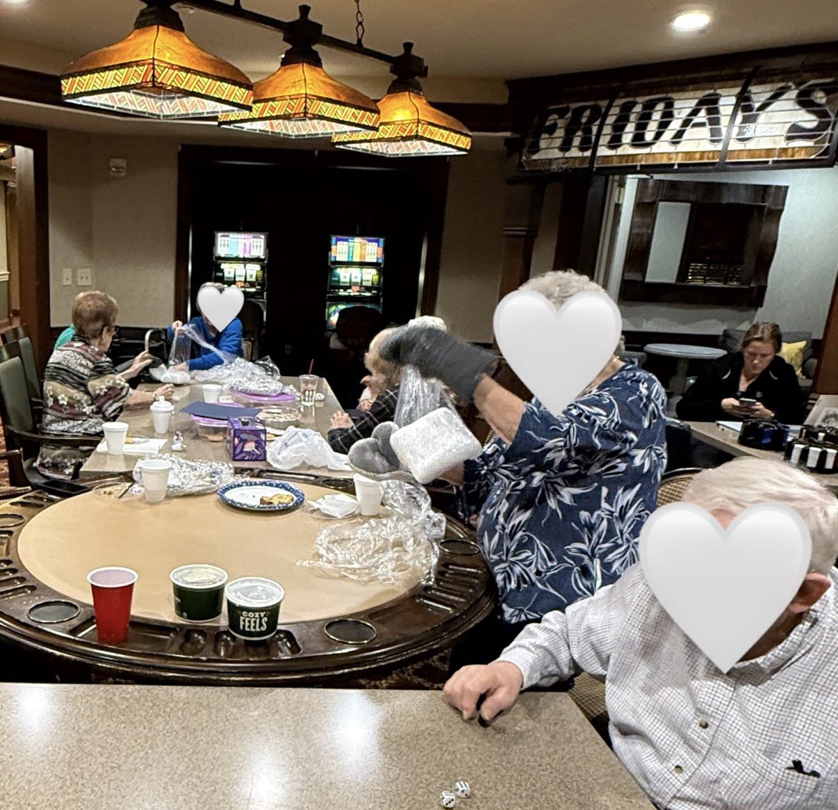

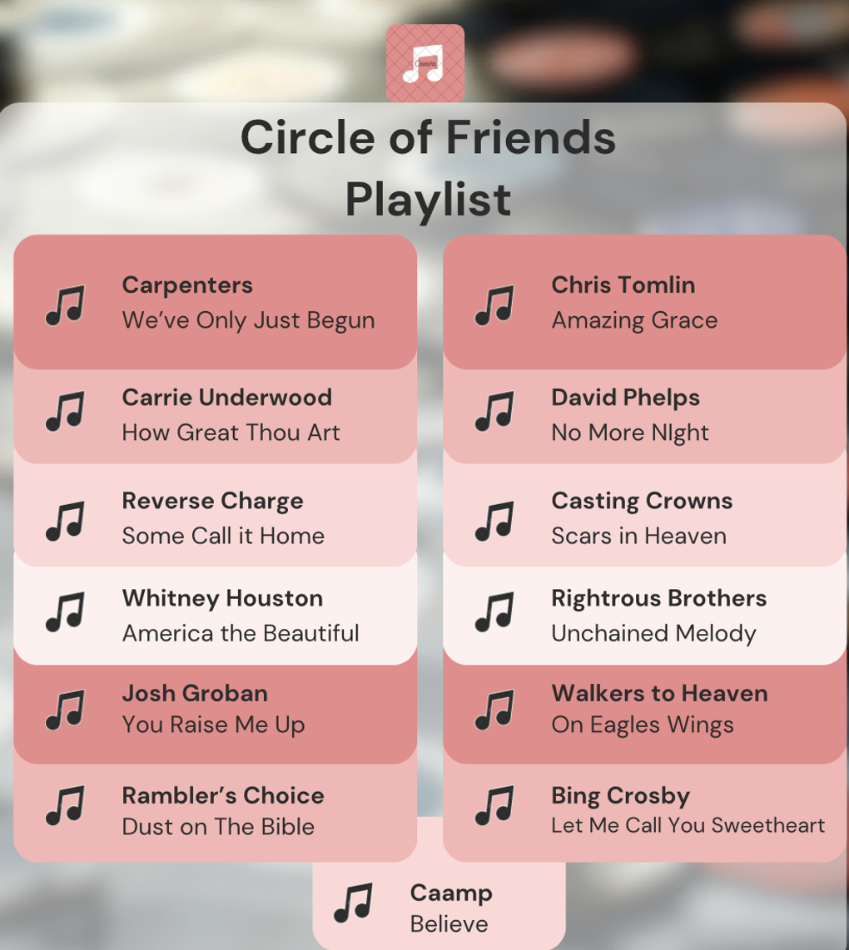
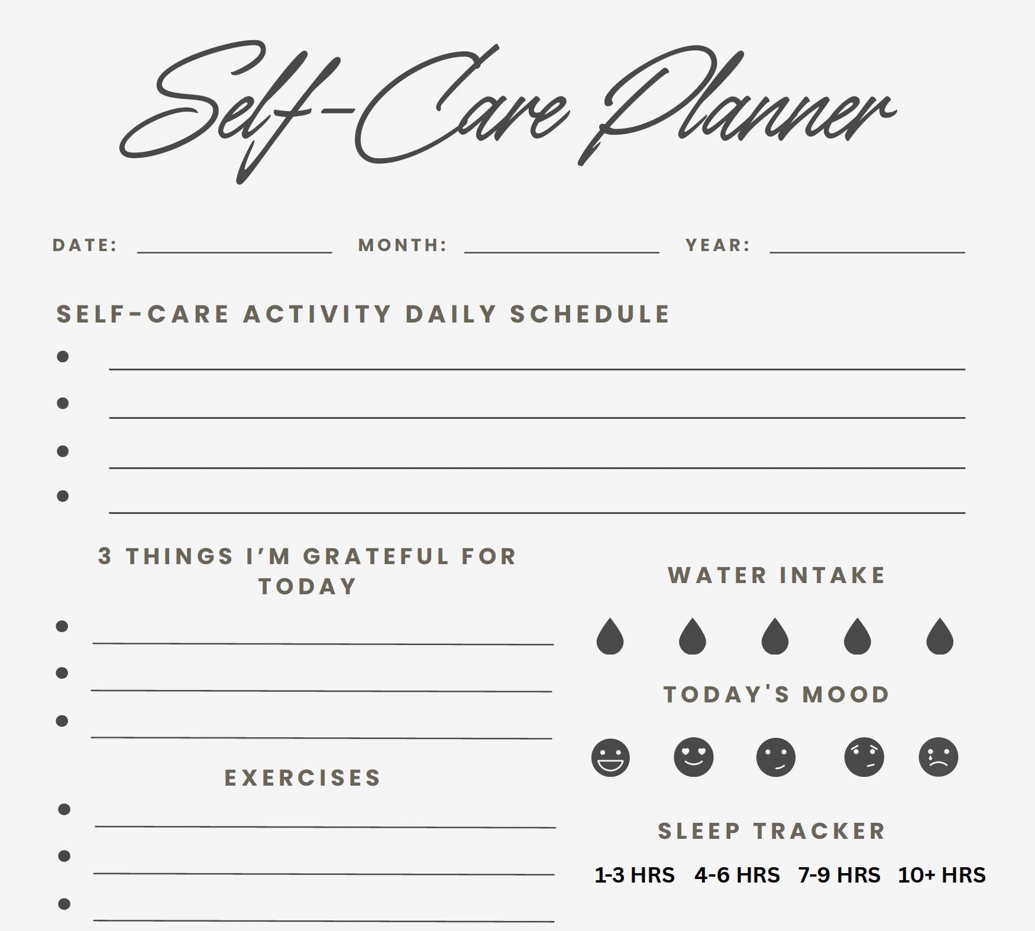
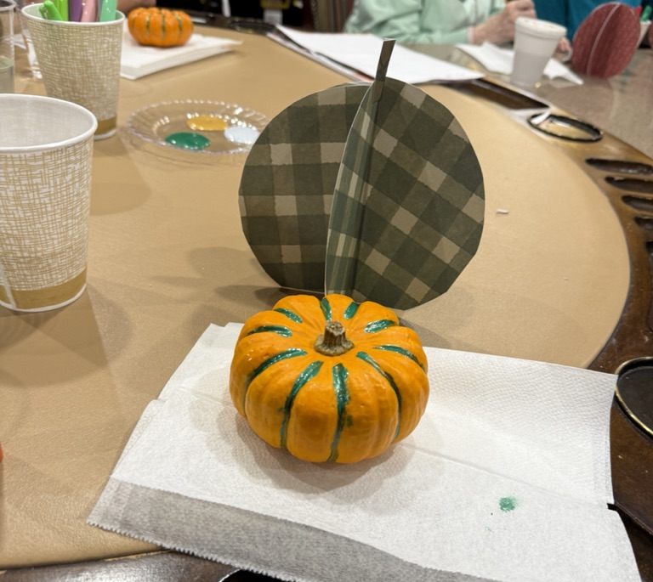
Activities
Chair Yoga and Mindfulness Exercises
Group Games
Themes
  Exercise and Wellness
  Therapeutic Writing/Reflection
  Arts and Culture
TED Talks and Group Discussion
Group Playlist and Memory Sharing
Self-Care Journaling and Reflection
Seasonal Crafts

Slide 8
Results: Outcome Measures
*Statistically significant difference
Notes:
A statistically significant decrease was detected in the groups pre and post test scores on the Geriatric depression scale and R-UCLA loneliness scale
-Group means prior to the progam already fell within low risk for depression and loneliness but after participating in the group we saw an even larger decrease in scores reflecting that the program successfully helped to decrease depression and loneliness among participants

Slide 9
Results: Outcome Measures
*Statistically significant difference
Notes:
Next a statistically significant increase was detected in group mean scores on the rapid cognitive screen and lubben social network scale.
The group mean scores prior to the program fell within the category of normal cognition and low risk for social isolation but after program implementation we found an even larger increase in scores which shows the programs ability to improve cognition and social connectedness for participants

Slide 10
Results: Feedback Survey
Notes:
92% participants made a friend
83% though group met their needs
87% interested in continuing COF program
And all participants agreed/strongly agreed the group content was interesting

Slide 11
Results: Feedback Survey
Notes:
92% participants made a friend
83% though group met their needs
87% interested in continuing COF program
And all participants agreed/strongly agreed the group content was interesting

Slide 12
Impact of Circle of Friends
Impact at Chesterwood
  Significantly increased social connectedness and cognition
  Decreased feelings of depression and loneliness
  Participants feedback reflected acceptability and perceived value of CoF program at Chesterwood
    Expansion of the program throughout Chesterwood or additional buildings
Notes:
Even with a shortened version of the CoF program, the program helped to significantly increase social connectedness and improve cognition among participants while also decreasing feelings of loneliness and depression
Participant feedback reflected the acceptability and value of the program at chesterwood which leaves room for the expansion of the program to include more IL/AL residents or even explore implementing the program at additional buildings within the company such as long term care facilities or their memory care units

Slide 13
Implications for Occupational Therapy
Feedback supports use of OT skills in activity analysis and task adaptation to create interventions that meet resident needs
Supports the need for OT involvement in social and leisure interventions in continued care facilities to improve resident well-being
Notes:
Feedback especially regarding the group meeting their needs supports the use of OT skills of activity anaylisis and task adaptation to create interventions that meet resident’s needs
-We had 3 residents with visual impariments and about 7 that had impariments in mobility requiring a device to get around so we had to adapt our activities to meet these physical needs while also capturing the interests and abilities of the group as a whole so it was good to know that our activities were able to meet the groups general needs
The overall results of the project support the need for OT involvement in social and leisure interventions in continued care facilities to improve resident well being
-Social and leisure participation are important occupations that can improve OAs QoL and this project serves to support and advocate for our ablility to bill for and be reimbursed by insurance for these interventions in this setting in the future

Slide 14
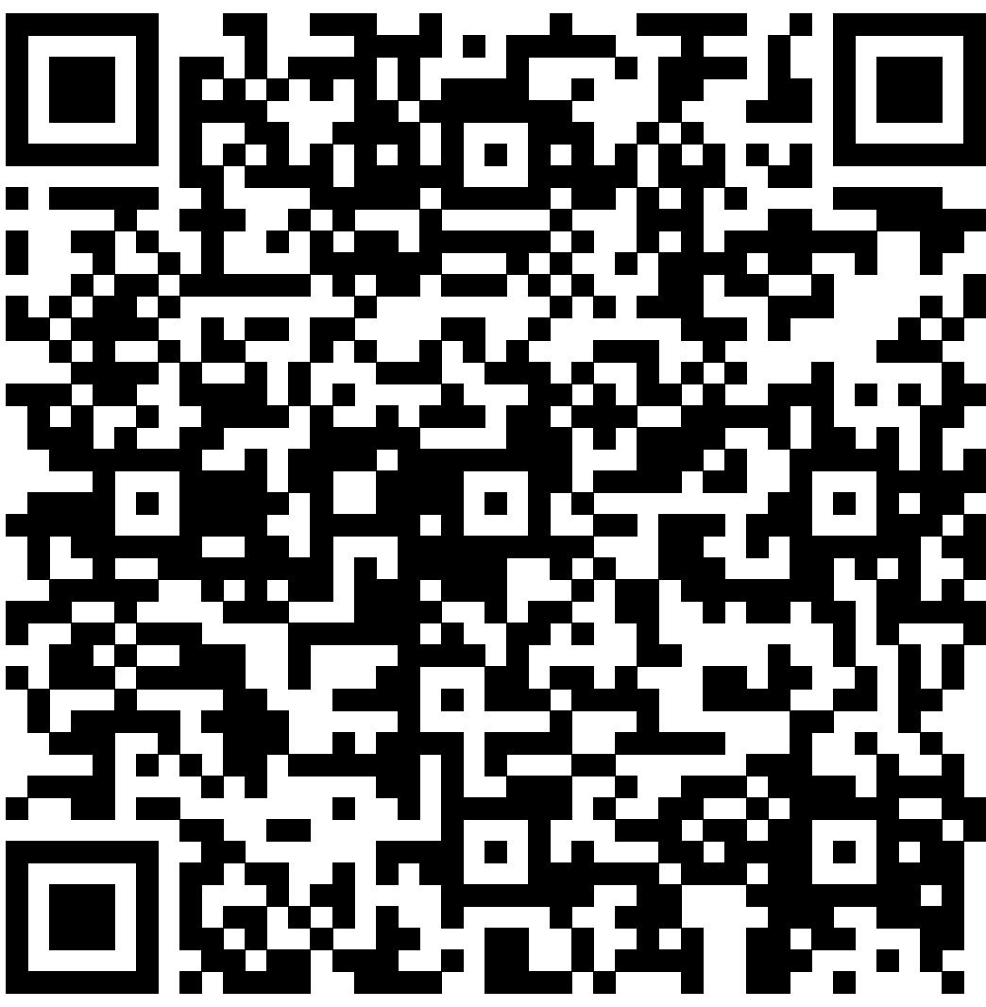

References

